Slide 1

Quantum Computation: Is Thailand Ready For It?
Sanpawat Kantabutra, PhD
The Theory of Computation Group and The Center of Excellence for Quantum Technology, Faculty of Engineering, Chiang Mai University
Email: sanpawat@alumni.tufts.edu

Slide 2
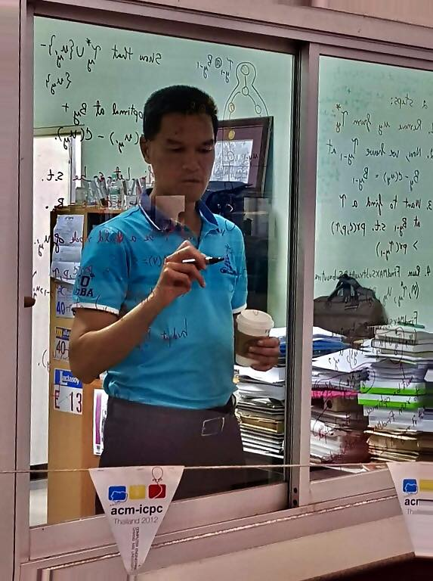
About Myself
Hold a PhD in Theoretical Computer Science from Tufts University in Boston.
Have done research in design and analysis of (classical) algorithms for 18 years.
Head of the problem preparation team for the Thailand Olympiad in Informatics, 2009-2010 and 2021-2022
Previously had no background in quantum physics but very good at mathematics.
Got into the field of quantum computing about 4 years ago.
Have taught and researched in quantum computation since.

Slide 3
Talk Outline
What is quantum computation?
Superposition, interference, and entanglement in relation to computation
Types of current quantum computers and their applications
Knowledge and skills needed in quantum computation
Quantum computation readiness for Thailand
Questions and answers

Slide 4
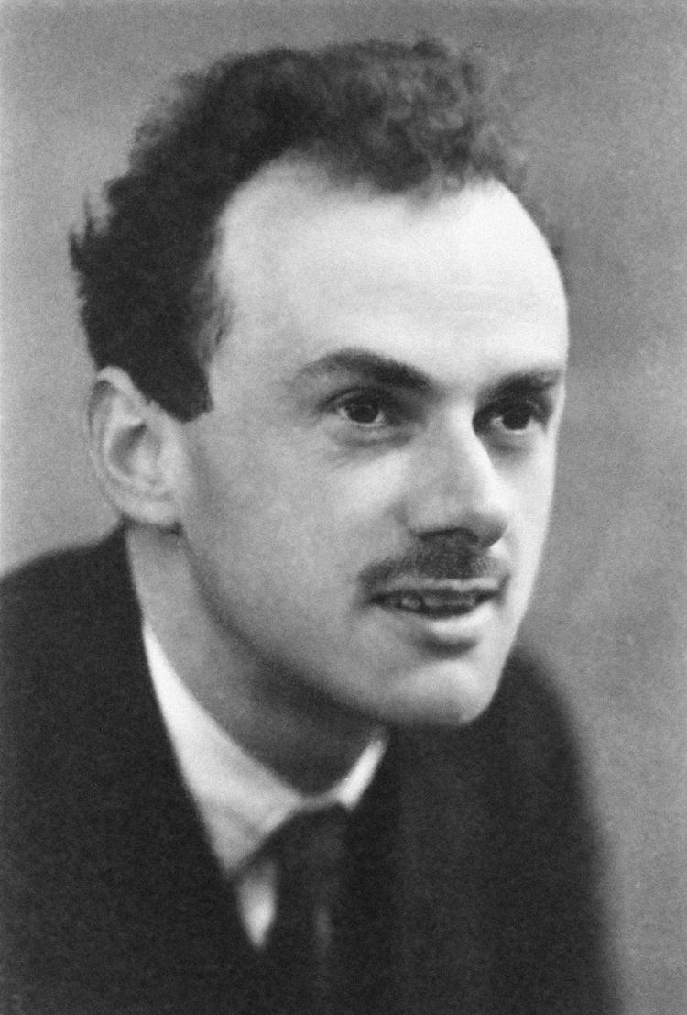
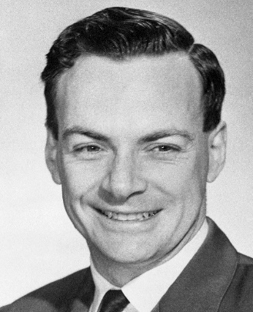
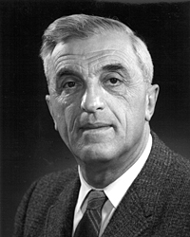
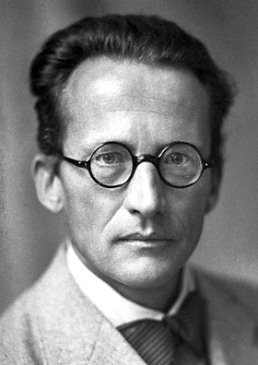
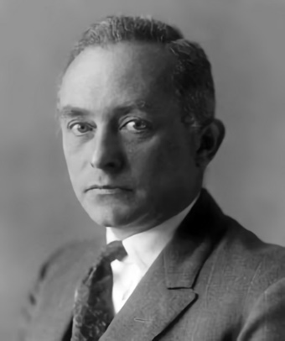
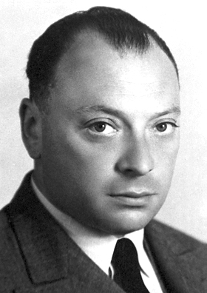
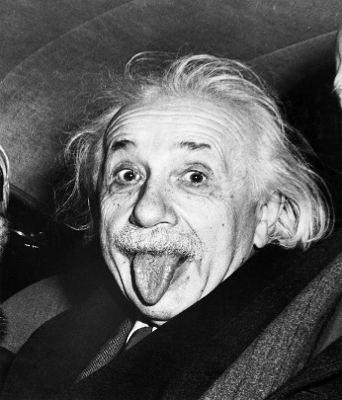
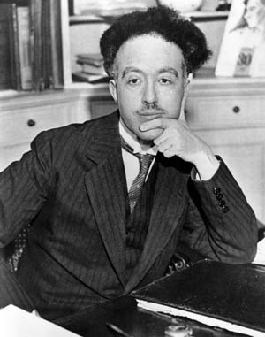
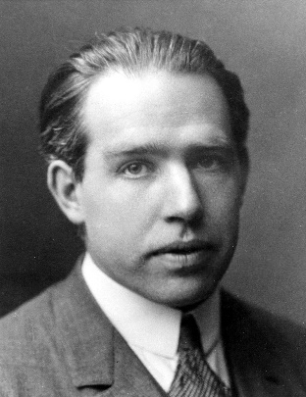
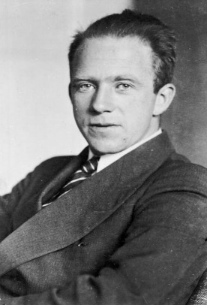
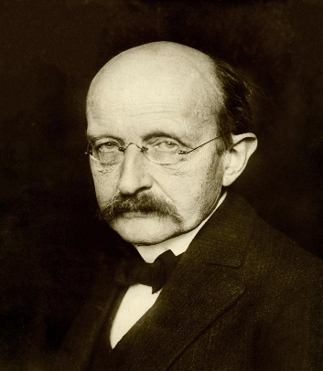
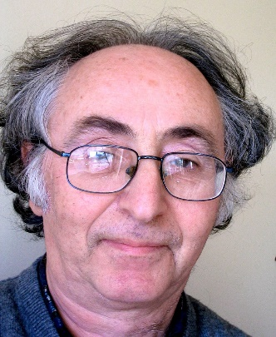
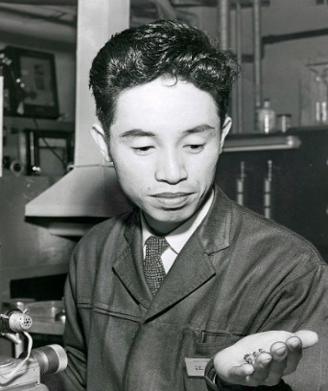
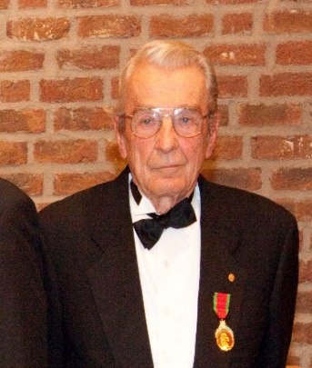
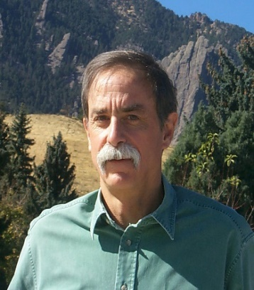
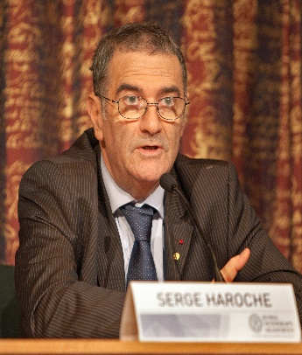
Many Contributions from Nobel Prize Laureates

Slide 5
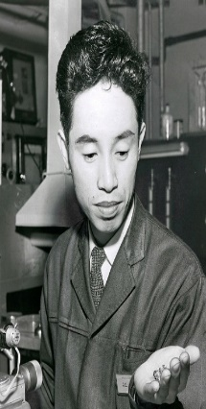


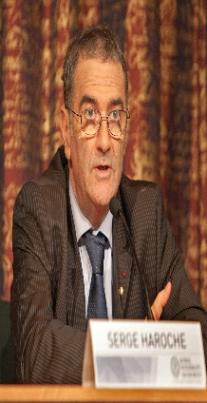
Textbooks/Papers on Quantum Computing
It is easy to see…
It is clear that…
It is not hard to see that…
Obviously, it means…
This part is left as an exercise for the reader.
If you think about it for a moment, you see that…

Slide 6

Textbooks on Quantum Mechanics/Computing
What?
It is easy to see…
It is clear that…
It is not hard to see that…
Obviously, it means…
This part is left as an exercise for the reader.
If you think about it for a moment, you see that…

Slide 7
What is quantum computation?
Computation is any type of calculation[1][2] that includes both arithmetical and non-arithmetical steps and which follows a well-defined model (e.g. an algorithm).
While classical computation follows a set of well-defined principles of classical physics, quantum computation follows a set of well-defined principles of quantum physics.
They are very different in terms of their main principles and the ways to think about solutions to a problem.

Slide 8
Superposition
Any data can be represented by classical bits 0 and 1.
The superposition principle states that a quantum object, which can exist in one of several possible states, can also exist in all of these states at once at the same time.
Suppose f : {0,1,2,3,4,5,6,7} → {0,1}. Classically, we must compute f(x) for each x in {0,1,2,3,4,5,6,7} one at a time.
Quantumly, we can compute f(0), f(1), f(2), f(3), f(4), f(5), f(6), f(7) in a single step by the principle of superposition.

Slide 9
Superposition
We can see the huge advantage when the domain gets exponentially large and f(x) is an algorithm to solve a certain problem.
We can compute all solutions in one step as opposed to an exponential number of steps in classical computation.
Recall that the number of stars in the Universe is approximately 10²⁴ < 2⁹⁶.
Theoretically, we could use only 96 qubits to compute 10²⁴ inputs of some function or algorithm in one single step! Exponential parallel processing power!

Slide 10
Superposition
Suppose f : {0,1} → {0,1} and f(0) = 1 and f(1) = 0.
Suppose the corresponding qubit state is
The catch is that we can only see one of the two outputs when we measure (read) the superposition state.
In this simple case, we only see f(0) or f(1) with equal probability 1/2 when we measure both qubits.

Slide 11
Superposition
Suppose f : {0,1} → {0,1} and f(0) = 1 and f(1) = 0.
Suppose the corresponding qubit state is
The catch is that we can only see one of the two outputs when we measure (read) the superposition state.
In this simple case, we only see f(0) or f(1) with equal probability 1/2 when we measure (read) both qubits.

Slide 12
Superposition
Generally, after an n-qubit computation, we have a following state.
where .
Quantum computation is about engineering the probability of the desired state outcome .
Typically this probability engineering requires a lot of ingenuity and creativity.

Slide 13
Superposition
Generally, after an n-qubit computation, we have a following state.
where .
Quantum computation is about engineering the probability of the desired state outcome .
Typically this probability engineering requires a lot of ingenuity and creativity.

Slide 14
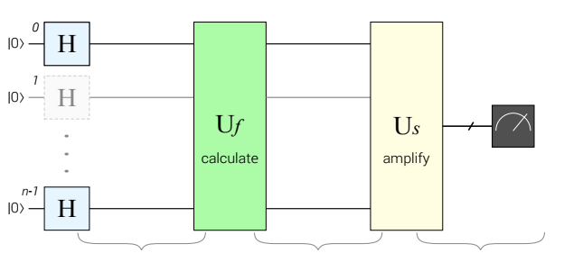
A General Quantum Computing Framework
Picture Credit: Quantum Programming Illustrated

Slide 15
A General Quantum Computing Framework
Picture Credit: Quantum Programming Illustrated

Slide 16
A General Quantum Computing Framework
Picture Credit: Quantum Programming Illustrated

Slide 17
A General Quantum Computing Framework
Picture Credit: Quantum Programming Illustrated

Slide 18
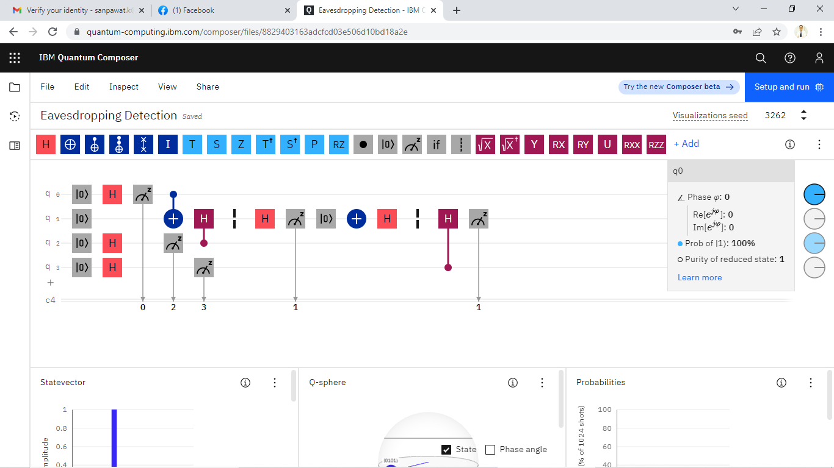
IBM Quantum Circuit for Spy Detection

Slide 19
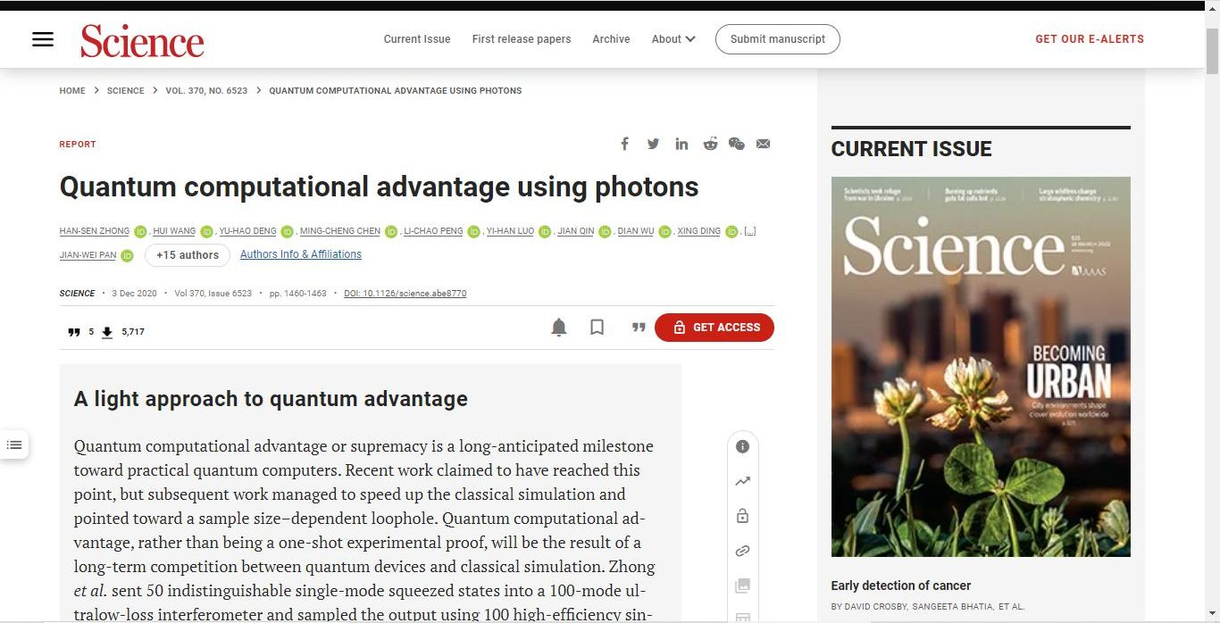
Quantum Supremacy
A system called Jiuzhang produced results in minutes calculated to take more than 2 billion years of effort by the world’s third-most-powerful supercomputer.

Slide 20
Interference
Quantum interference is the ability to manipulate superposition by adding (constructive interference) or subtracting (destructive interference) probability amplitudes of matching quantum states.
This ability is an important part of probability engineering mentioned earlier.
Using interference, quantum computer scientists must design these interferences so that the desired output is the outcome when it is read.

Slide 21
Interference Example
Suppose we have this qubit state .
We want to see when we read this state. We need to cancel .

Slide 22
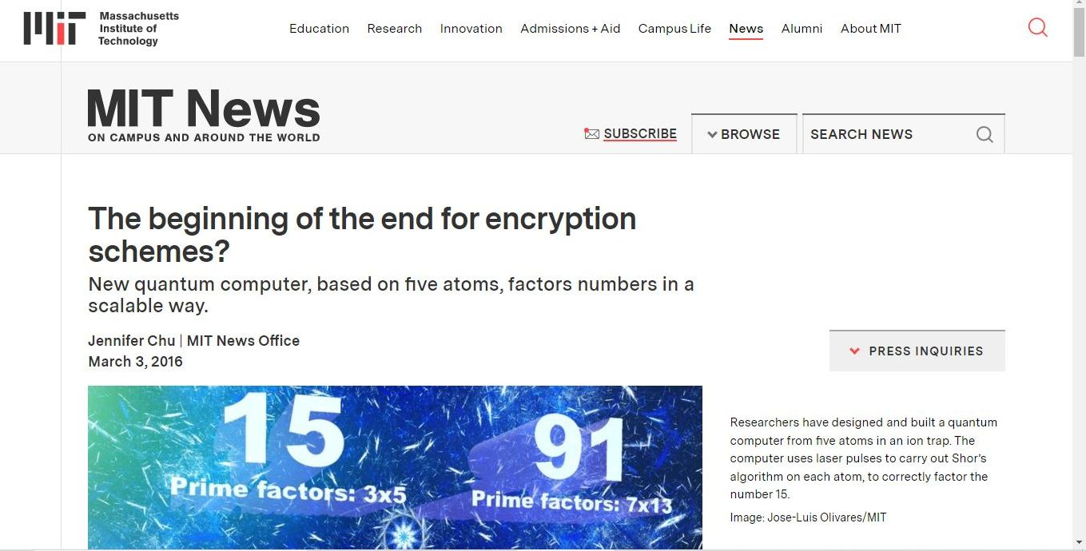
Shor’s Factoring Algorithm

Slide 23
Entanglement
Entanglement is a form of superposition in which a pair of qubits share the same quantum state.
Changing the state of one of the qubits instantly affects the state of the other one regardless of the distance between them.
The result obtained by measuring one of the qubits completely determines the measurement result of the other qubit.
Example: Bell’s pair

Slide 24
Use of Entanglement in Communication
Suppose Alice and Bob share the Bell’s pair.
Each takes one qubit from the entangled pair and travels to different destinations far away from each other.
At her destination Alice measures her qubit. Suppose she sees 0. She knows in advance that Bob will get 0 when he measures his qubit.

Slide 25
Use of Entanglement in Communication
Suppose Alice and Bob share the Bell’s pair.
Each takes one qubit from the entangled pair and travels to different destinations far away from each other.
At her destination Alice measures her qubit. Suppose she sees 0. She knows in advance that Bob will get 0 when he measures his qubit.

Slide 26
Entangled State in Three or More Qubits
By the same method that Alice and Bob use in their communication, we now can
communicate among 3, 4, and 5 or billion people.

Slide 27
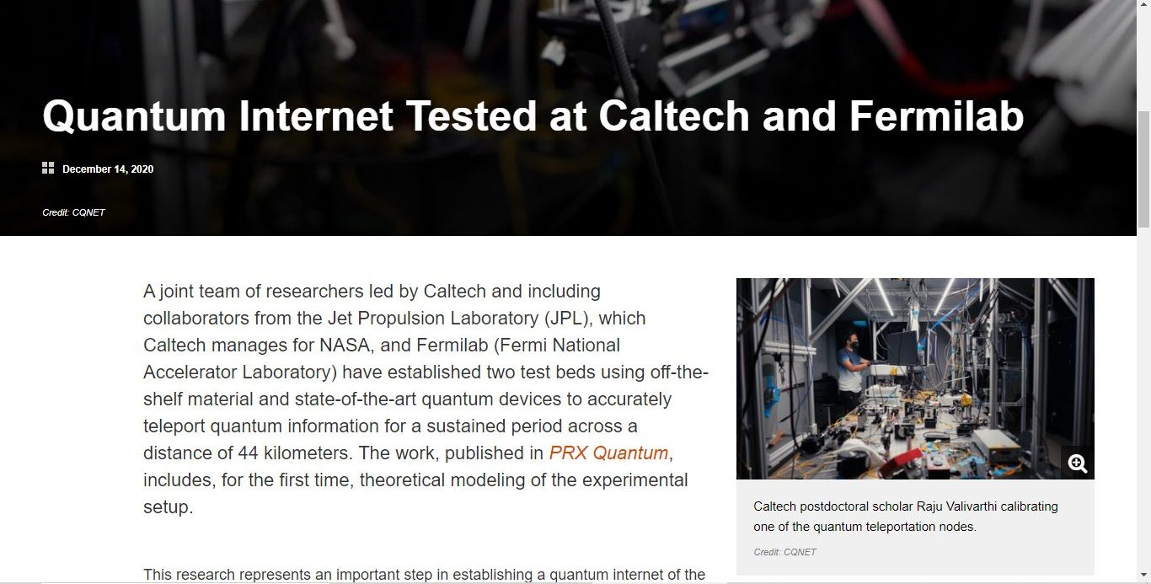
Quantum Internet

Slide 28
No Cloning Theorem
In classical computation a copy of a state or a variable can be done.
In quantum computation a copy of a qubit state is not possible by the no cloning theorem.
We use quantum teleportation instead.

Slide 29
Types of Current Quantum Computers
Analog quantum computers
Directly manipulate qubits without primitive gates
Include quantum annealers such as D-Wave
Noisy intermediate-scale quantum (NISQ) gate-based computers
Apply primitive gate operations on physical qubits
Noisy and error-prone
Fully error-corrected quantum computers
Emulate logical qubits for reliable computation

Slide 30
Knowledge and Skills Needed for Quantum Computation
Linear algebra
Quantum physics
Programming skills in Python
Mathematical maturity, critical thinking, and creativity
Design and analysis of classical algorithms is a plus.
Ability to tell which problem is suitable for quantum computer. Usually, NP-hard problems are indicative.

Slide 31
Example 1: Shor’s Factoring Algorithm

Slide 32
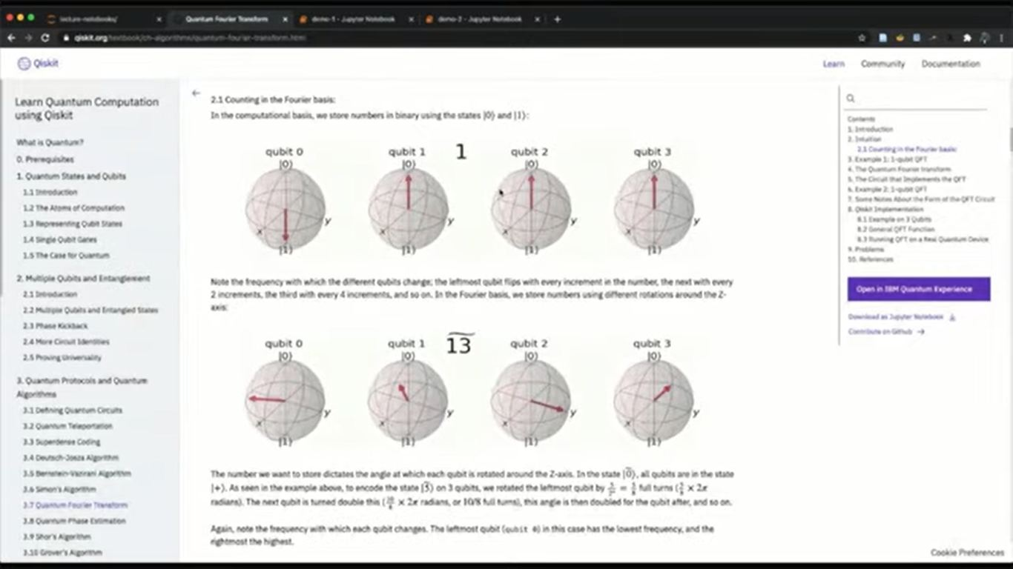
Example: Shor’s Factoring Algorithm

Slide 33
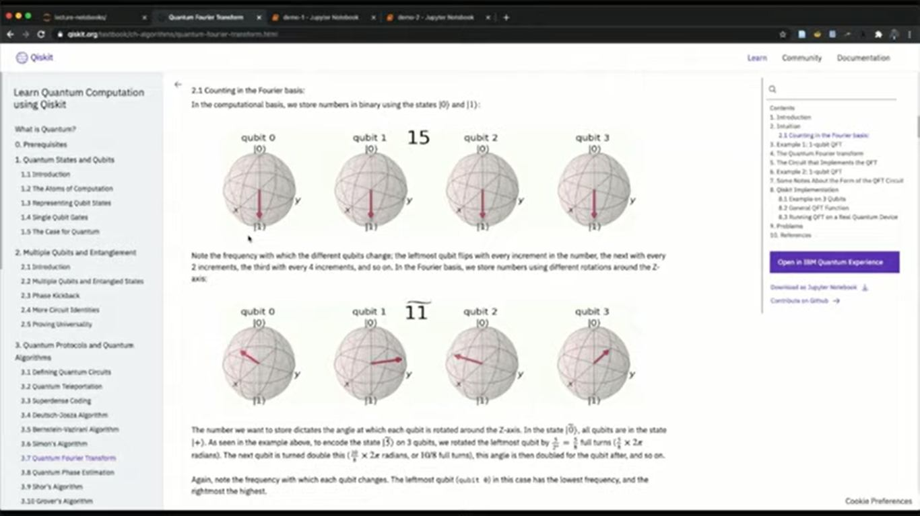
Example: Shor’s Factoring Algorithm

Slide 34
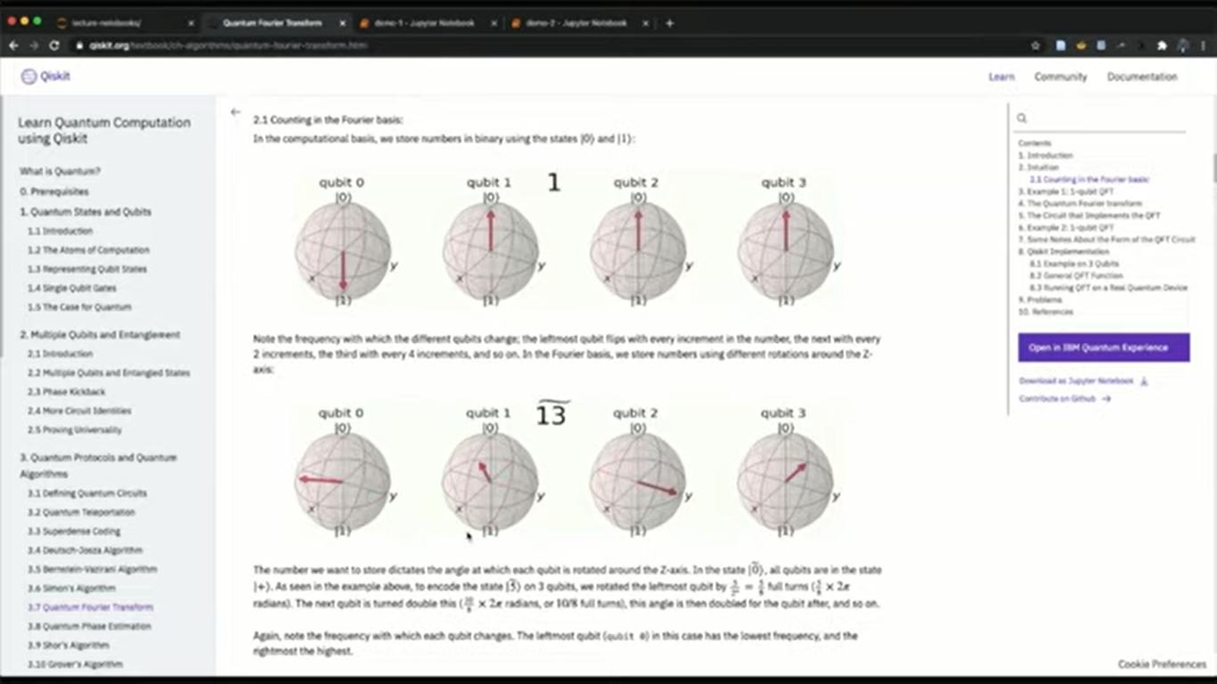
Example: Shor’s Factoring Algorithm

Slide 35
Example 2: Simultaneous Wireless Communication is NP-Hard

Slide 36
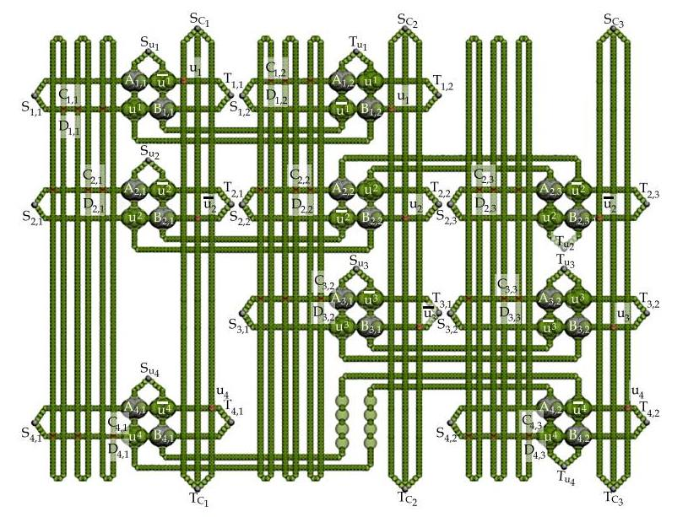

Slide 37
Example 3: K-Clustering

Slide 38
K-Clustering is one such example as it is NP-hard [12].
Recall that, given an integer K, the problem of K-Clustering is to group “similar” points in the same clusters while putting “unsimilar” points in different clusters.

Slide 39











US Institutions with Curricula in Quantum Computing

Slide 40















Countries with Quantum Computation Curricula

Slide 41















Countries with Quantum Computation Curricula

Slide 42



Thai Institutions With Some Courses In Quantum Computation

Slide 43
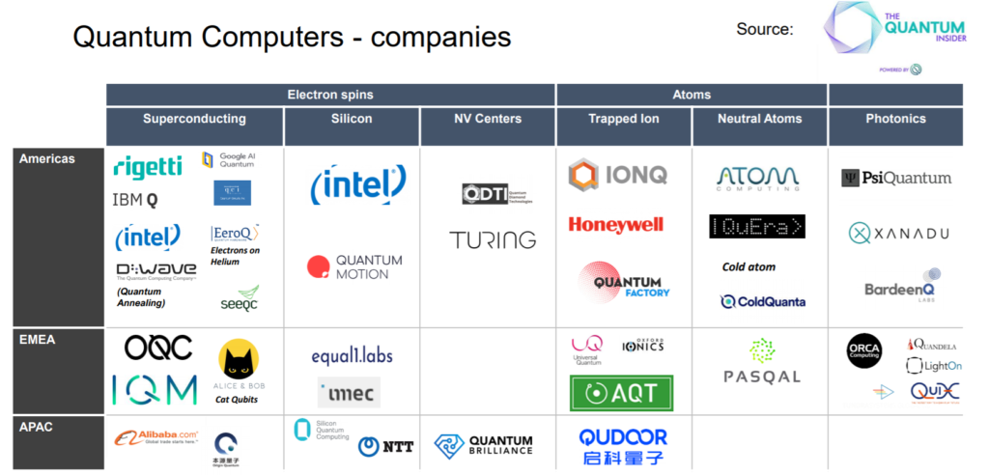
Foreign Quantum Computer Companies

Slide 44

Thai Quantum Computer Company

Slide 45
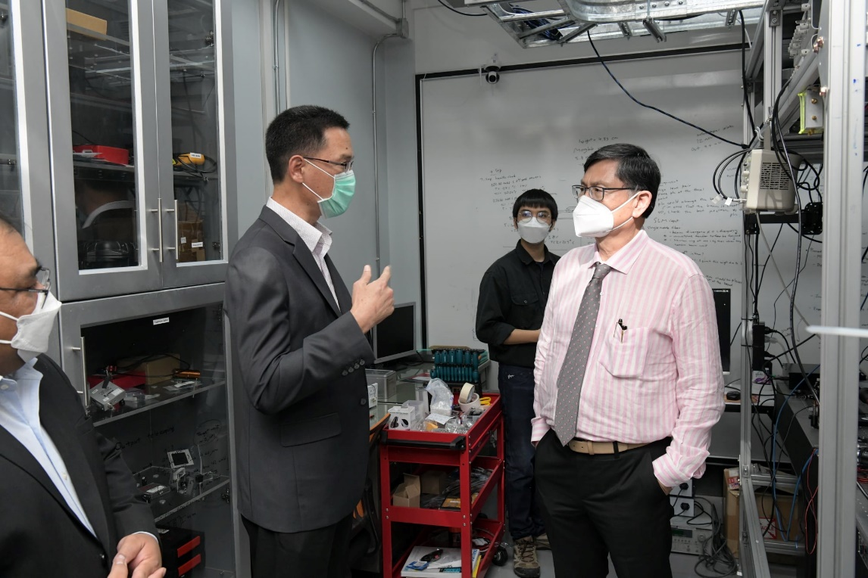
Quantum Computation: Is Thailand ready for it?
Currently we have about 50-60 quantum physicists in Thailand but none was educated in quantum computation and information.
We also have a few theoretical computer scientists who have become quantum computer scientists.
How long will quantum computer become reality? 5 years? 10? or more?

Slide 46
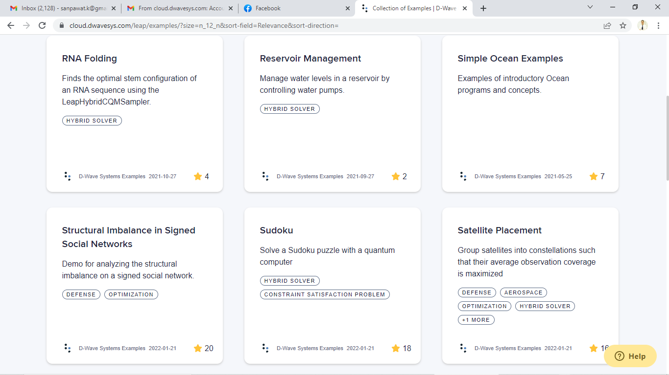
Hybrid Computation (D-Wave)

Slide 47
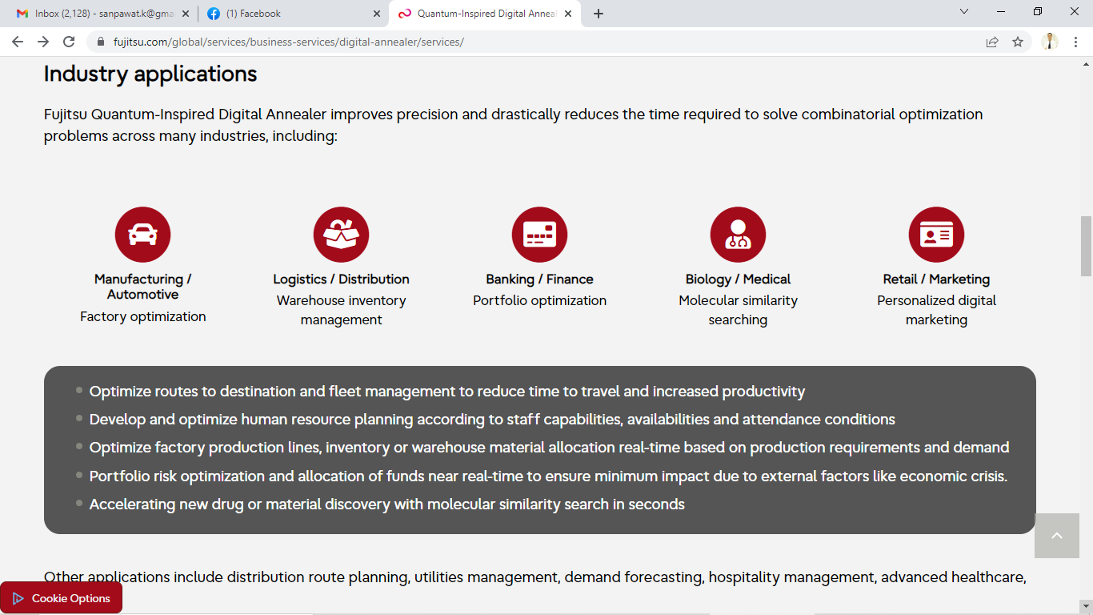
Quantum-Inspired Computation (Fujitsu)

Slide 48
Questions and Answers

Slide 49
References
[1] Computation from the Free Merriam-Webster Dictionary
[2] "Computation: Definition and Synonyms from Answers.com". Answers.com. Archived from the original on 22 February 2009. Retrieved 26 April 2017.
[3] Apolloni, Bruno; Cesa-Bianchi, Nicolo; De Falco, Diego (July 1988). "A numerical implementation of quantum annealing". Stochastic Processes, Physics and Geometry, Proceedings of the Ascona-Locarno Conference.
[4] Apolloni, Bruno; Carvalho, Maria C.; De Falco, Diego (1989). "Quantum stochastic optimization". Stoc. Proc. Appl. 33 (2): 233–244. doi:10.1016/0304-4149(89)90040-9

Slide 50
References
[5] Kadowaki, T.; Nishimori, H. (1998). "Quantum annealing in the transverse Ising model". Phys. Rev. E. 58 (5): 5355. arXiv:cond-mat/9804280. Bibcode:1998PhRvE..58.5355K. doi:10.1103/PhysRevE.58.5355. S2CID 36114913.
[6] Karp RM. Reducibility among combinatorial problems. In: Miller RE, Thatcher JW, and Bohlinger JD, editors. Complexity of Computer Computations. New York, NY: Plenum Press (1972), p. 85. doi: 10.1007/978-1-4684-2001-2_9
[7] Garey MR, Johnson DS. Computers and Intractability: A Guide to the Theory of NP-Completeness. San Francisco, CA : W.H. Freeman (1979).

Slide 51
References
[8] https://www.zdnet.com/article/a-quantum-computer-just-solved-a-decades-old-problem-three-million-times-faster-than-a-classical-computer/#:~:text=Windows%2011-,A%20quantum%20computer%20just%20solved%20a%20decades%2Dold%20problem%20three,be%20achieved%20over%20classical%20means.
[9] Peter W. Shor, Polynomial-Time Algorithms for Prime Factorization and Discrete Logarithms on a Quantum Computer, SIAM J. Sci. Statist. Comput. 26(1997) 1484.

Slide 52
References
[10] Bennett, C.H., DiVincenzo, D.P., Smolin, J.A. and Wootters, W.K. (1996). Mixed state entanglement and quantum error correction. Physical Review A, 54, 3824–3851. DOI: https://doi.org/10.1103/PhysRevA.54.3824.
[11] Laflamme, R., Miquel, C., Paz, J.-P. and Zurek, W.H. (1996). Perfect quantum error correction code. Physical Review Letters, 77(1), 198–201. DOI:https://doi.org/10.1103/PhysRevLett.77.198.
[12] Vattani, A. The hardness of k-means clustering in the plane. https://cseweb.ucsd.edu/~avattani/papers/kmeans_hardness.pdf

Slide 53
Q&A

